Slide 1
Modern version history 🚀

Slide 2





Dan Toft
Microsoft 365 Consultant Denmark
Blog.Dan-Toft.dk
@Tanddant
Notes:
Dan

Slide 3


Tobias Maestrini
Microsoft 365 Consultant Switzerland
@tmaestrini
Notes:
Tobias

Slide 4
Agenda
Demo
Why built it?
Code
Summary
Notes:
Dan

Slide 5

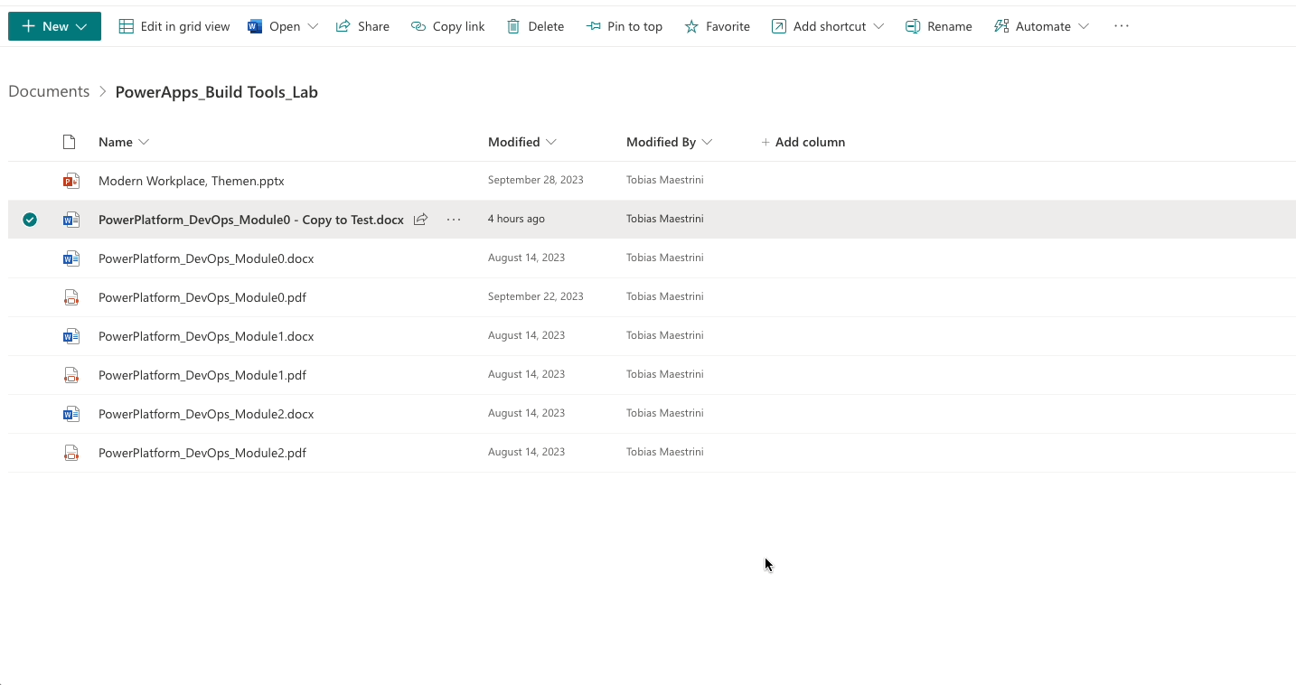
Why
«Classic SharePoint should’ve been gone before I even was born» (Dan)
Built-in experience loads slowly
Modern history extension features:
See what has changed in a given period of time
See which changes have been made by a specific user
See the full version for a given date
Compare any (two) versions
Get an approval overview
👆 Built-in version history experience
Notes:
Toby (bullet points shortened for brevity; explanations in the presentation will be expanded)
We are all familiar with the standard version history in SharePoint Online
One particular challenge is the restriction on the number of versions recorded - unfortunately there is nothing you can do about this
What we keep stumbling over is... (although Dan is right: [Dan's quote])
… Keeping the version overview under control can be very challenging
This is where our extension comes in and offers five useful features.
(features will be covered and discussed in the demo – see next slide)

Slide 6
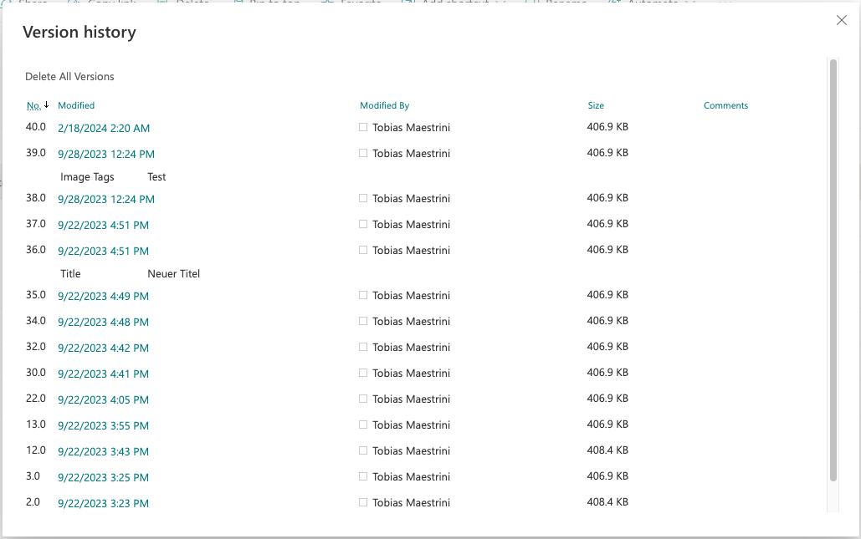
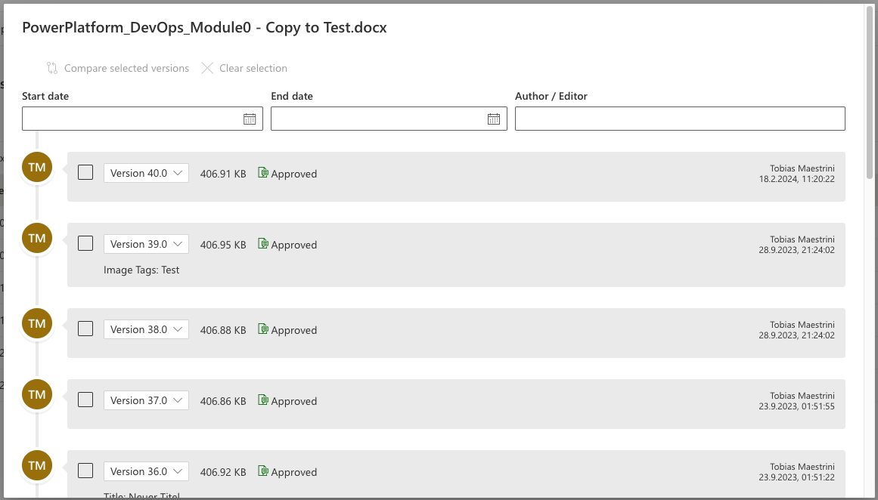
Why (…)
👆 «before» (built-in)
👆 «after» (by Dan & Toby)
Notes:
Toby
Typical questions that you encounter when searching for a particular version
Explain our idea to provide an easy-to-understand user interface with additional capabilities: showing the basic metadata of a file or item, providing filtering and comparison capabilities, integrating with the modern look of SharePoint Online and a faster loading time

Slide 7

Demo
Notes:
Toby (bullet points shortened for brevity; explanations in the presentation will be expanded)
Faster loading (quick comparison of the built-in version history with our version)
Describe the features (Dan clicks through and adds his comments):
Filter by date
Filter by editor
Preview a specific version
Compare any two versions
Approval overview

Slide 8
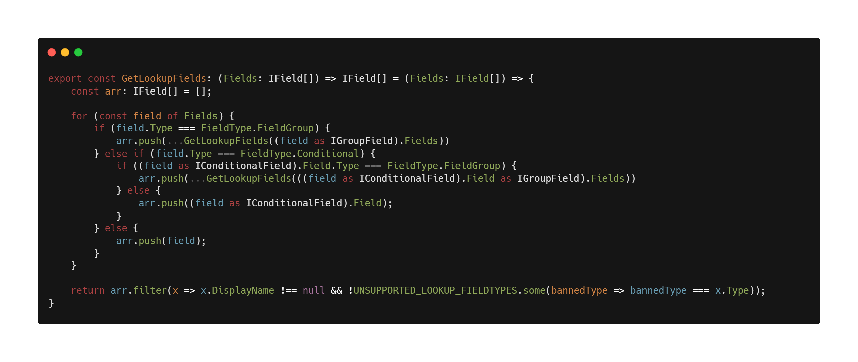
Notes:
Dan

Slide 9

Summary
Building on top of M365 is a great way to extend what’s possible
Some APIs are missing, and you’ll have to “reverse engineer” – this is not supported, but at times necessary
Building things together is FUN!
Notes:
Dan?

Slide 10

Thank you!
Tobias Maestrini
Dan Toft
@tmaestrini
Blog.Dan-Toft.dk
@Tanddant
Slides: https://github.com/tanddant/slides
Sample: https://github.com/pnp/sp-dev-fx-extensions/tree/main/samples/react-modern-version-history
Notes:
Together 🙌

